Slide 1
Haor Flood Management and Livelihood Improvement Project (BWDB Part) Recent Progress Report
Presented By
A.K.M Shamsul Alam,
Project Director

Slide 2
Contents of The Presentation
Flood Situation in the project area(Damage)
Revised design/Design of the pilot embankment construction and plan for implementation of pilot construction.
Activity plan for civil works next two dry seasons
Status of Agriculture component and plan for next FY
Discussion on civil works monitoring format

Slide 3
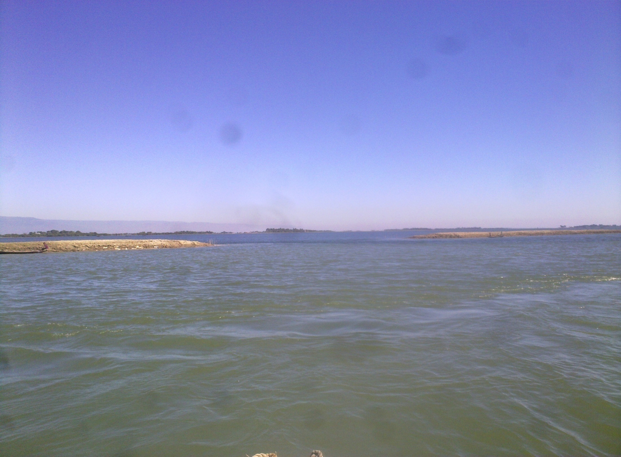
Haor Area During Pre Monsoon

Slide 4
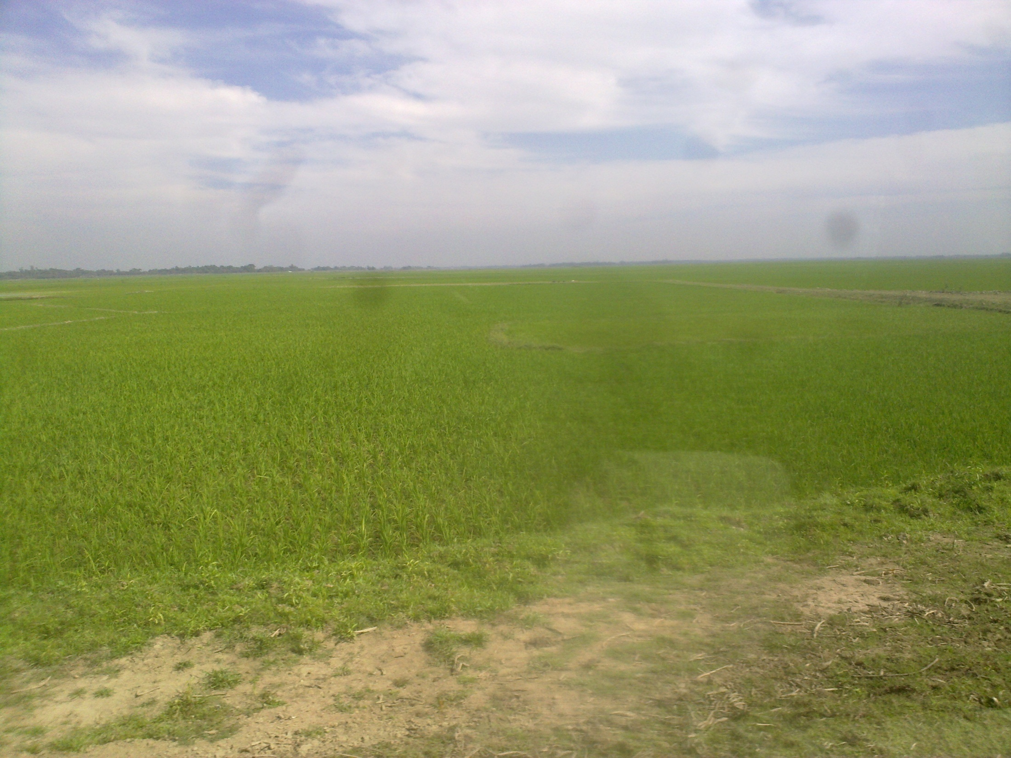
BORO RICE FIELD DURING DRY SEASON IN HAOR AREA

Slide 5
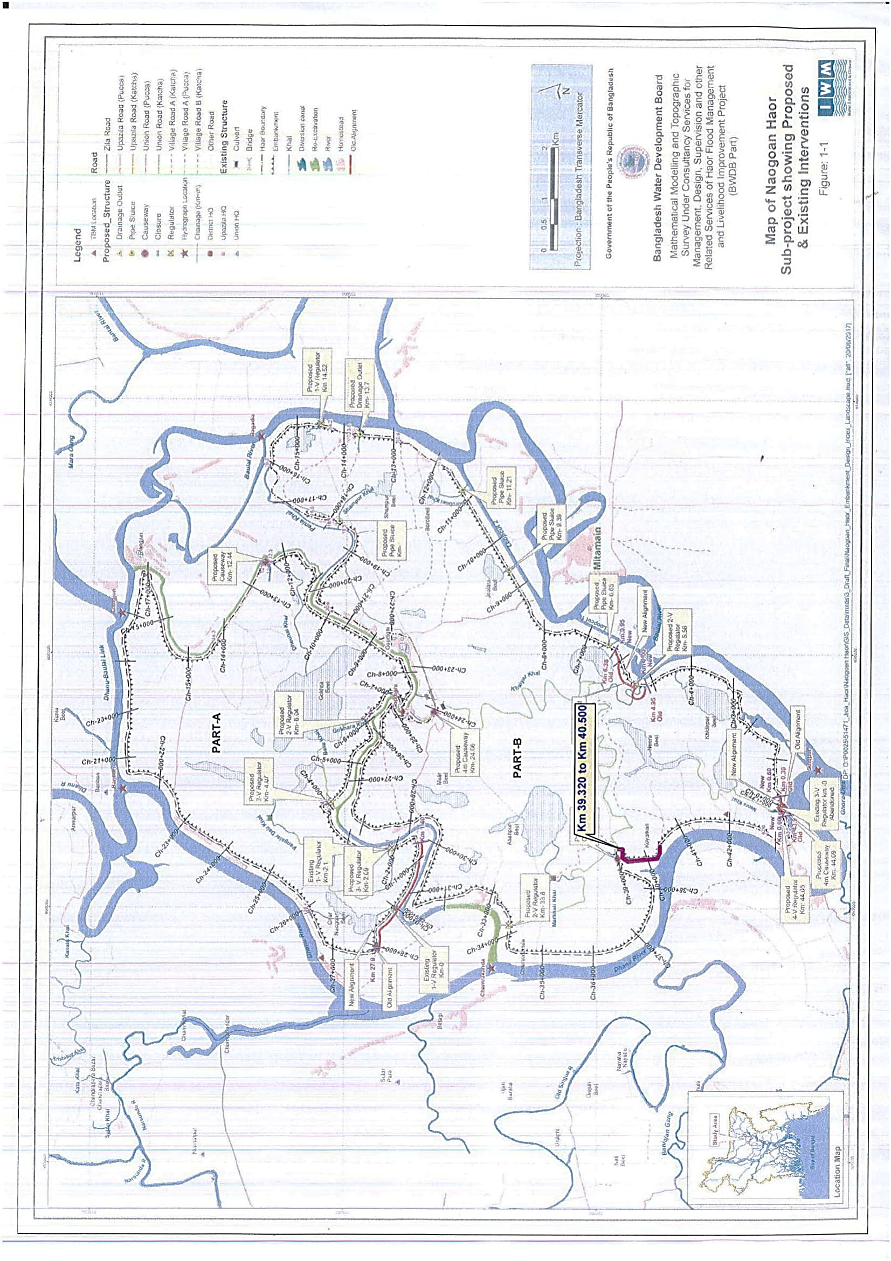

Slide 6
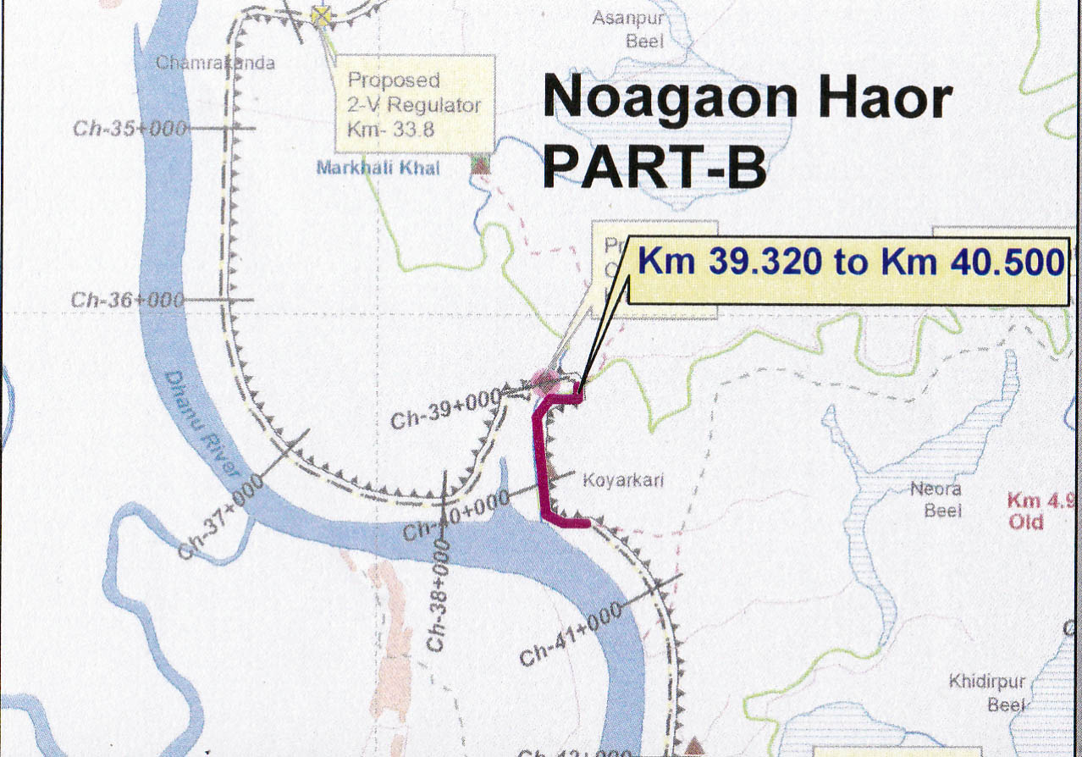
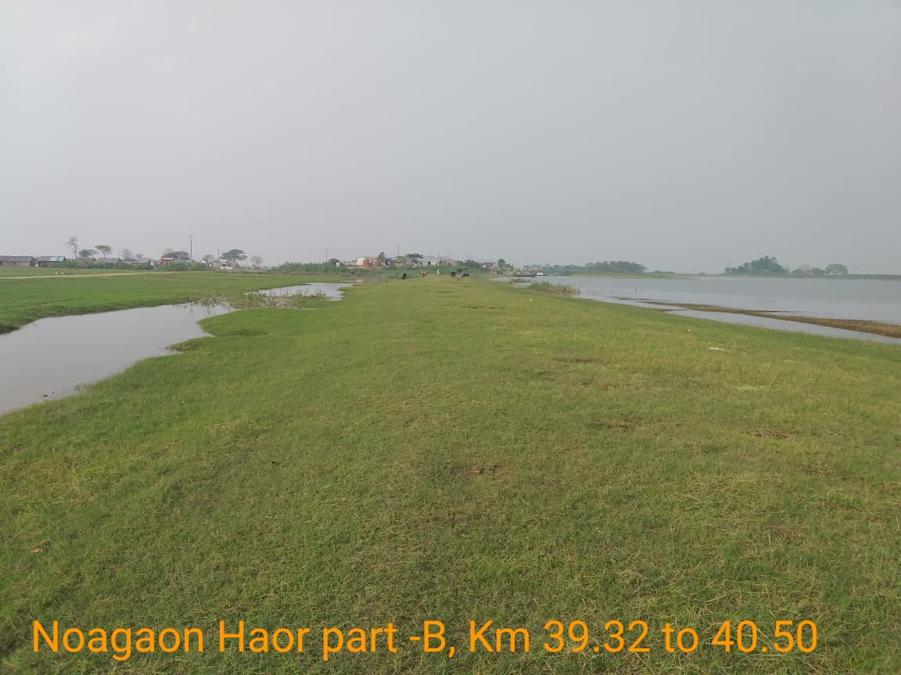
3.2 Findings (Noagaon Haor Part-B 39.32 to 40.50)
05-11-2020
Dec 11, 2019
March 9, 2020

Slide 7
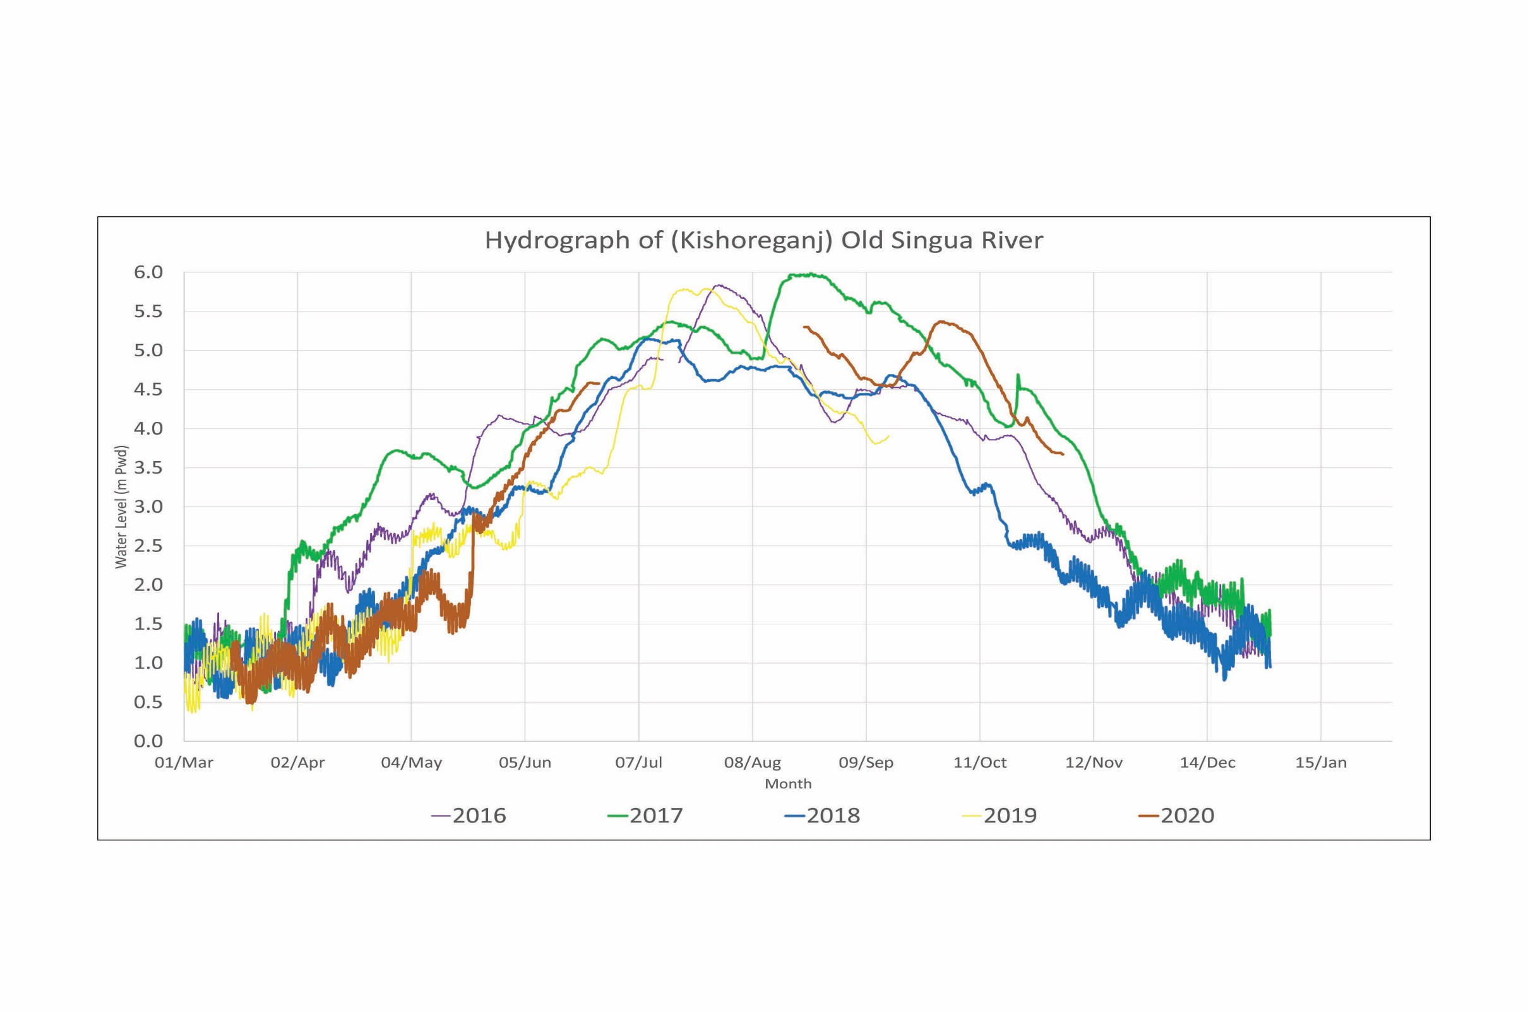

Slide 8
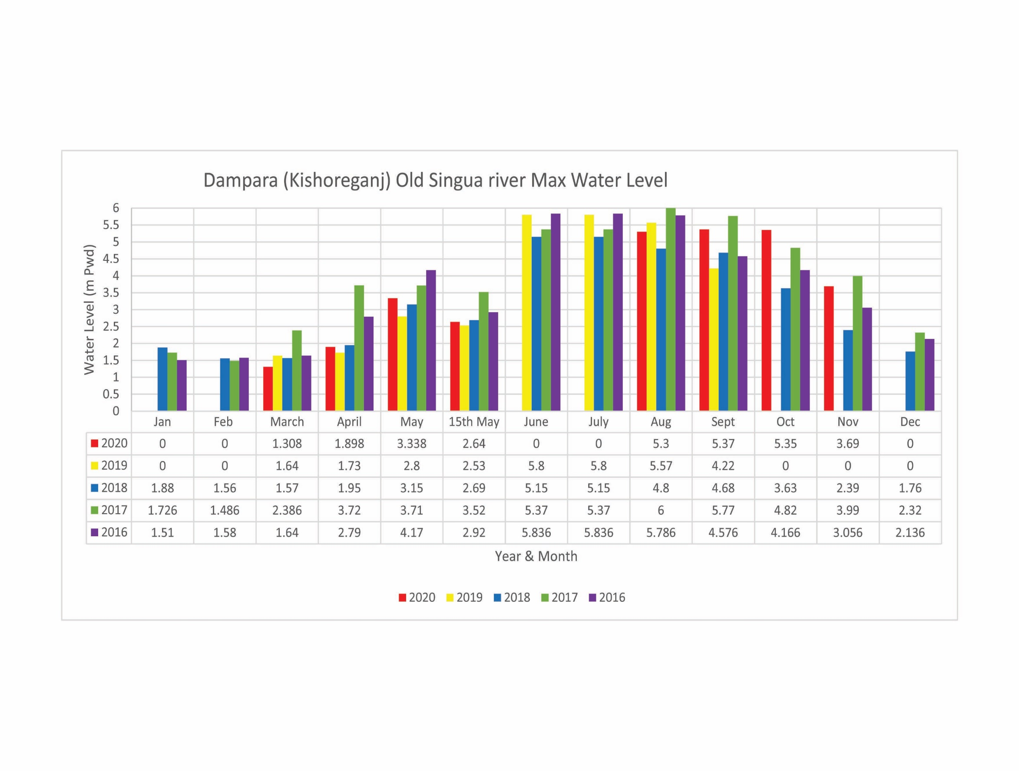
Avg. Crest level of S/E 4.50 m-PWD
Max WL at 15th May 3.52 m-PWD
Average GL 2.10 m-PWD

Slide 11
Avg. Crest level of S/E 6.57 m-PWD
Max WL at 15th May 5.00 m-PWD
Average GL 4.50 m-PWD

Slide 13
2. Revised design/Design of the pilot embankment construction and plan for implementation of pilot construction.
2.1 Type A Protection Work
2.2 Type B5 Protection Work
2.3 Flood Fuse

Slide 14
Total estimated cost for 7 (Seven) nos. Packages for Protection of Damaged Portion of Embankment:
Sl. No. | Name of Haor | Type- A | Type- B | Type- D | Fuse Type (Length in km.) | Total length (km) | Total estimated cost (in Million.) | Date of Tender Floated | Date of Tender Receive | Remarks
 |  | (Length in km.) | (Length in km.) | (Length in km.)
1 | 2 | 3 | 4 | 5 | 6 | 7 | 8 | 9 | 10 | 11
1 | Naogaon Haor Part–A Kishoregonj, BWDB/Kish/HFMLIP/ PW-30). | 1.681 | 0.700 | 0 | 0 | 2.381 | 146.983 | 11/8/2020 | 12/7/2020
2 | Naogaon Haor Part–A Kishoregonj, BWDB/Kish/HFMLIP/ PW-31) | 0.990 | 1.640 | 0 | 0.030 | 2.660 | 120.028 | 11/8/2020 | 12/7/2020
3 | Naogaon Haor Part–B Kishoregonj (BWDB/Kish/HFMLIP/ PW-32) | 1.082 | 1.542 | 0 | 0.030 | 2.654 | 156.373 | 11/8/2020 | 12/7/2020
4 | Kishoregonj Naogaon Haor Part–B, Kishoregonj (BWDB/Kish/HFMLIP/PW-33) | 1.090 | 0 | 1.155 | 0.000 | 2.245 | 146.843 | 11/8/2020 | 12/7/2020
5 | Dakshiner Haor/ Noagaon Haor (BWDB/Kish/HFMLIP/PW-34). | 1.094 | 1.097 | 0 | 0.045 | 2.236 | 147.702 | 11/8/2020 | 12/7/2020
6 | Dakshiner Haor/Noapara Haor/ Nunnir Haor (BWDB/Kish/HFMLIP/PW-35) | 0.620 | 4.425 | 0 | 0 | 5.045 | 91.462 | 11/8/2020 | 12/7/2020
7 | Dharmapasha Rui beel Project. Sunamgonj (BWDB/Sunam/HFMLIP/PW-07) | 0.341 | 3.039 | 0 | 0.060 | 3.440 | 127.007 | 10/21/2020 | 11/23/2020
 | Total | 6.898 | 12.443 | 1.155 | 0.165 | 20.661 | 936.398

Slide 15
Protection Type (Type A)

Slide 16
Protection Type (Type B5)

Slide 17
Flood Fuse

Slide 18
Flood Fuse

Slide 19
Flood Fuse

Slide 20
1.Activity Plan for civil works next two dry season
1.1 Physical Achievement up to October 2020
1.2 Current Activities of Component 3-1
1.3 Current Concerns

Slide 21
1.1 Physical Achievement up to 30thOctober, 2020
Sl No. | Item of Physical Work as per 1st RDPP |  |  |  |  | Progress up to 30th October, 2020 | Progress (%)
 | Name | Quantity | No of Package | Cost in Crore Taka | On going Packages
1 | 2 | 3 | 5 | 4 | 6 | 7 | 8
New Haor: (14 Nos.) |  |  | 52 Nos |  | Kishoregonj 27 Nos. Habigonj 6 Nos. Netrokona 8 Nos. Sunamgonj 6 Nos. Total 47 Nos. Contract Price of 47 Nos. Packages = 472.37 Crore
1 | Construction of Submersible Embankment | 263.24 km |  | 119.53 |  | 156 km (Full) +54 km (Part)= 210 km | 72.57%
2 | Re-excavation of Khal/River | 318.20 km |  | 97.29 |  | 187 km (Full) +73.00 km (Part) = 260 km | 72.53%
3 | Construction of Regulator/ Causeway/Drainage Box Outlet | 137nos (57+35+1+44) |  | 203.11 |  | 50 nos. (Full) +30 nos. (Part) = 80 Nos. | 49.64%
4 | Construction of Irrigation Inlet | 131 nos. |  | 12.61 |  | 43 nos. (Full) +17 Nos. (Part) = 60 Nos. | 40.61%
5 | Rehabilitation of Regulator | 8 nos. |  | 1.66 |  | 1 No (Full) = 1 No. | 12.50%
Rehabilitation Haor: (15 Nos.)
1 | Construction of Submersible Embankment | 87.03 km |  | 17.85 |  | 51 km (Full) +4 Km (Part) = 55 km. | 61.36%
2 | Construction of Full Embankment | 84.31 km |  | 25.50 |  | 53 km (Full) +12 km (Part) = 65 km | 71.40 %
3 | Re-excavation of Khal/River | 143.00 km |  | 25.15 |  | 65 km (Full) +15.00 km (Part)= 80 km | 51.75%
4 | Re-installation/Construction of regulator/ Causeway | 7 nos. |  | 15.15 |  | 1 No. (Full) = 1 No. | 14.29%
5 | Replacement of Gate | 104 nos. |  | 3.63 |  | 43 nos. (Full) = 43 Nos. | 41.35%
6 | Construction of WMG Office | 60 Nos. |  | 13.80 |  | 4 nos. (Full) +4 Nos. (Part) = 8 Nos. | 10.67%
 | Total |  | 52 Nos. | 535.27
Physical Progress = 63 %

Slide 22
Financial Status of JICA Money
SL | Description | Amount
1. | Total Fund for Livelihood & Physical work | = 515.44 Crore
2. | Total expenditure up to Sept. 2020 | = 294.18 Crore
 | Remaining Fund | = 221.26 Crore
Fund requirement
1. | October to December, 2020 | = 4.20 Crore
2. | January to March, 2021 | = 41.70 Crore
3. | April to June, 2021 | = 85.00 Crore
 | Total | = 130.90 Crore
Fund requirement
 | July, 2021 to June, 2022 | = 90.30 Crore

Slide 23
Sl. No. | Tender Status as per 2nd RDPP | Remarks
1 | 55 Nos of Packages As Per 2nd RDPP 47 Packages already Tender and work is on going.8 Nos Packages is Completed Upto October,2020.
2 | Remaining 9 Packages are to be tendered the F/Y (2020-21) ,already for 8 nos package tender is floated. 1 no Package for Gate Replacement at Satdona & Chahal Beel Sub-Project in Brahmanbaria District.
Financial Year | Tender Invitation (No) | Contract Completion (No)
2016-17 | 9
2017-18 | 19
2018-19 | 15 | 8
2019-20 | 4
2020-21 | 8
Total | 55 | 8

Slide 24
Cumulative Progress of Project (upto 30-09-2020) : Financial = 59381.08 Lakh (61.09%)
Physical = 73%
Reasons for difference of progress (Financial & Physical).
RDPP Item & Task with cost | Expenditure incurred (%) | Physical (%)
Consultancy: Total amount : Tk. 7901.40 Planning Review Sub Soil Investigation Design Estimate Monitoring & Supervision RAP Implementation Environmental Study | 5618.01 (71.10%) | 80%
Physical Work : Total amount : Tk. 53727.00 Detailed Estimate Tender Float Notification of Award (NOA) Work Order (W/O) Mobilization Work done | 30875.04 (57.47%) | 68%
RDPP Item & Task with cost | Expenditure incurred (%) | Physical (%)
Land Acquisition 240 ha Tk. 24000.00 (Lakh) | 15323.60 (63.85%) | 65%
Tax and VAT : Total amount : Tk. 2596.27 | 1809.73 (69.70%) | 69%
Procurement of Goods & Vehicles : Total amount : Tk. 1066.22 | 856.62 (80.34%) | 80%
Office Administration: Total amount : Tk. 3660.54 Salary of Out Sourcing staff Office Rent Gas & Petrol Repair Maintenance Others | 2228.44 (60.88%) | 60%
Total : Tk. 97204.86 | 59381.08 (61.09%) | 73%
Contingency : Total amount : Tk. 660.14 | 0 | 0
Grand Total amount : Tk. 97865.00 | - | -
Livelihood Improvement by Agriculture Promotion: Total amount : Tk. 4253.43 Local Training APSS SIGS | 2669.63 (62.76%) | 69%

Slide 27
Financial Expenditure (In Million BDT)
Sl no | Financial Year | Physical Progress | GOB | Project Aid (PA) |  |  |  | Total | Cumulative expenditure (in Million BDT)
 |  |  |  | RPA |  | Total RPA | DPA For Consultant
 |  |  |  | Civil Works | Livelihood
1 | 2 | 3 | 4 | 5 | 6 | 7 | 8 | 4+5+6+7
1 | 2014-15 | 1.5% | 60.662 | 0.0000 | 0.00 | 0.00 | 84.96 | 145.6 | 145.6
2 | 2015-16 | 4.0% | 82.428 | 0.0000 | 0.92 | 0.92 | 184.94 | 268.3 | 413.9
3 | 2016-17 | 10.5% | 555.849 | 91.2730 | 34.91 | 126.18 | 109.32 | 791.3 | 1205.3
4 | 2017-18 | 19.0% | 782.197 | 656.3710 | 78.98 | 735.35 | 68.93 | 1586.5 | 2791.7
5 | 2018-19 | 19.0% | 631.334 | 970.3530 | 93.99 | 1064.35 | 68.64 | 1764.3 | 4556.1
6 | 2019-20 | 17.0% | 312.082 | 975.1960 | 39.82 | 1015.01 | 45.00 | 1372.1 | 5928.2
7 | 2020-21 (30thSept-20) | 2.0% | 9.948 | 0.0000 | 0.00 | 0.00 | 0.00 | 9.948 | 5938.1
Total |  | 73.0% | 2434.5 | 2693.2 | 248.6 | 2941.8 | 561.8 | 5938.1

Slide 28
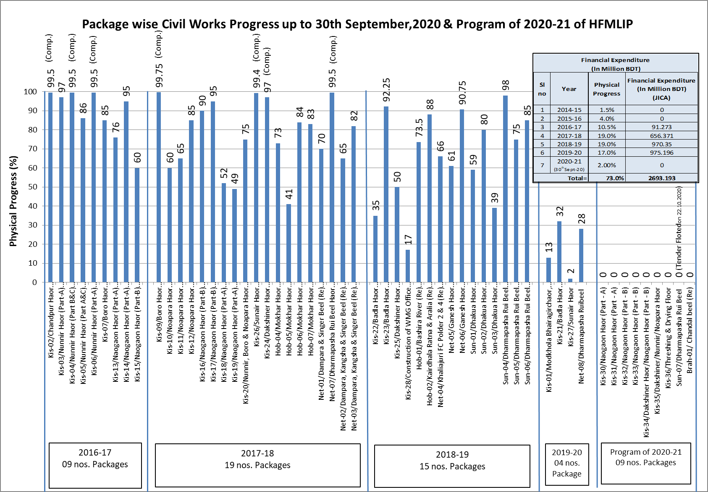

Slide 29
1.2 Current Status of Component 3-1
 | Scope | Major Activities | Target in DPP (2nd rev) | Achievement up to Feb 2020
A | WMO | - Committee Formation | 373 | 299
B | Local Training | - BWDB officials, Field staff, WMG members. | 11,700 WMG Members | 9,400 WMG Member
C | Agriculture Promotion Support Sub-Project (APSS) | - Farmer Training Program, - Demonstrations of crops, rice. - Farmer School Establishment | 69,983 Members | 42,482 Members
D | Small Scale Income Generation Sub-Project (SIGS) | - Homestead Vegetable - Cultivation and Support Service, etc | 26,867 Members | 15,264 Members
 |  | Total | 108,550 Members | 67,146 Members
Note: The International Expert, Mr Matsumoto will be mobilized later March.

Slide 30
4. Status of Agriculture component and plan for next FY

Slide 31
Allocation & Achievement
Upto 30 September, 2020

Slide 32
Upto 30 September, 2020

Slide 33
Upto 30 September, 2020

Slide 34
Upto 30 September, 2020

Slide 35
*Deposition progress downed in 2019-20 due to Pandemic COVID-19
Upto 30 September, 2020

Slide 36
Upto 30 September, 2020

Slide 37
Upto 30 September, 2020

Slide 38
Upto 30 September, 2020
Output: i) 18,16,892 Nos Egg from 1,19,960 Nos distributed duck
ii) 952 Nos kids from 3,858 Nos distributed Goat

Slide 39
Upto 30 September, 2020
Name of demonstration item

Slide 40
Upto 30 September, 2020

Slide 41
Upto 30 September, 2020

Slide 42
Upto 30 September, 2020

Slide 43
Proposed Budget for 2nd Revised DPP and Achievement Upto June'2020

Slide 46
1.3 Current Concerns
Slow Land Acquisition
Approval of the 2nd revised DPP including Protection Work (Expected this week)

Slide 47
2. Status of Protection Work
2.1 Procurement Status
Tender is already live.
The work will be undertaken in the next dry season.(Probably Within 15/12/2020).

Slide 48
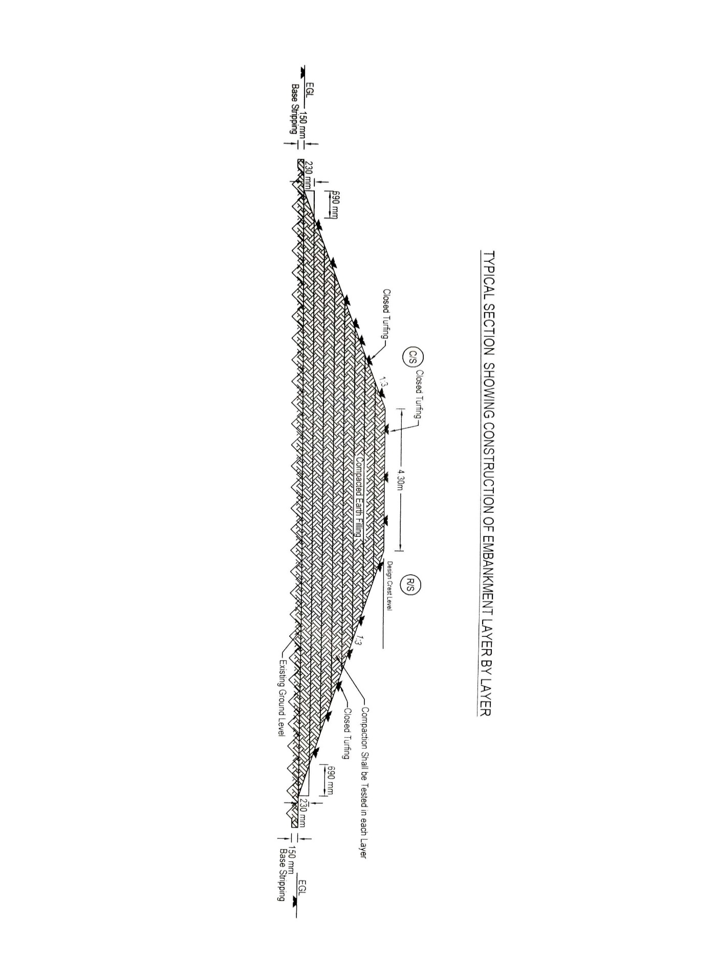

Slide 49
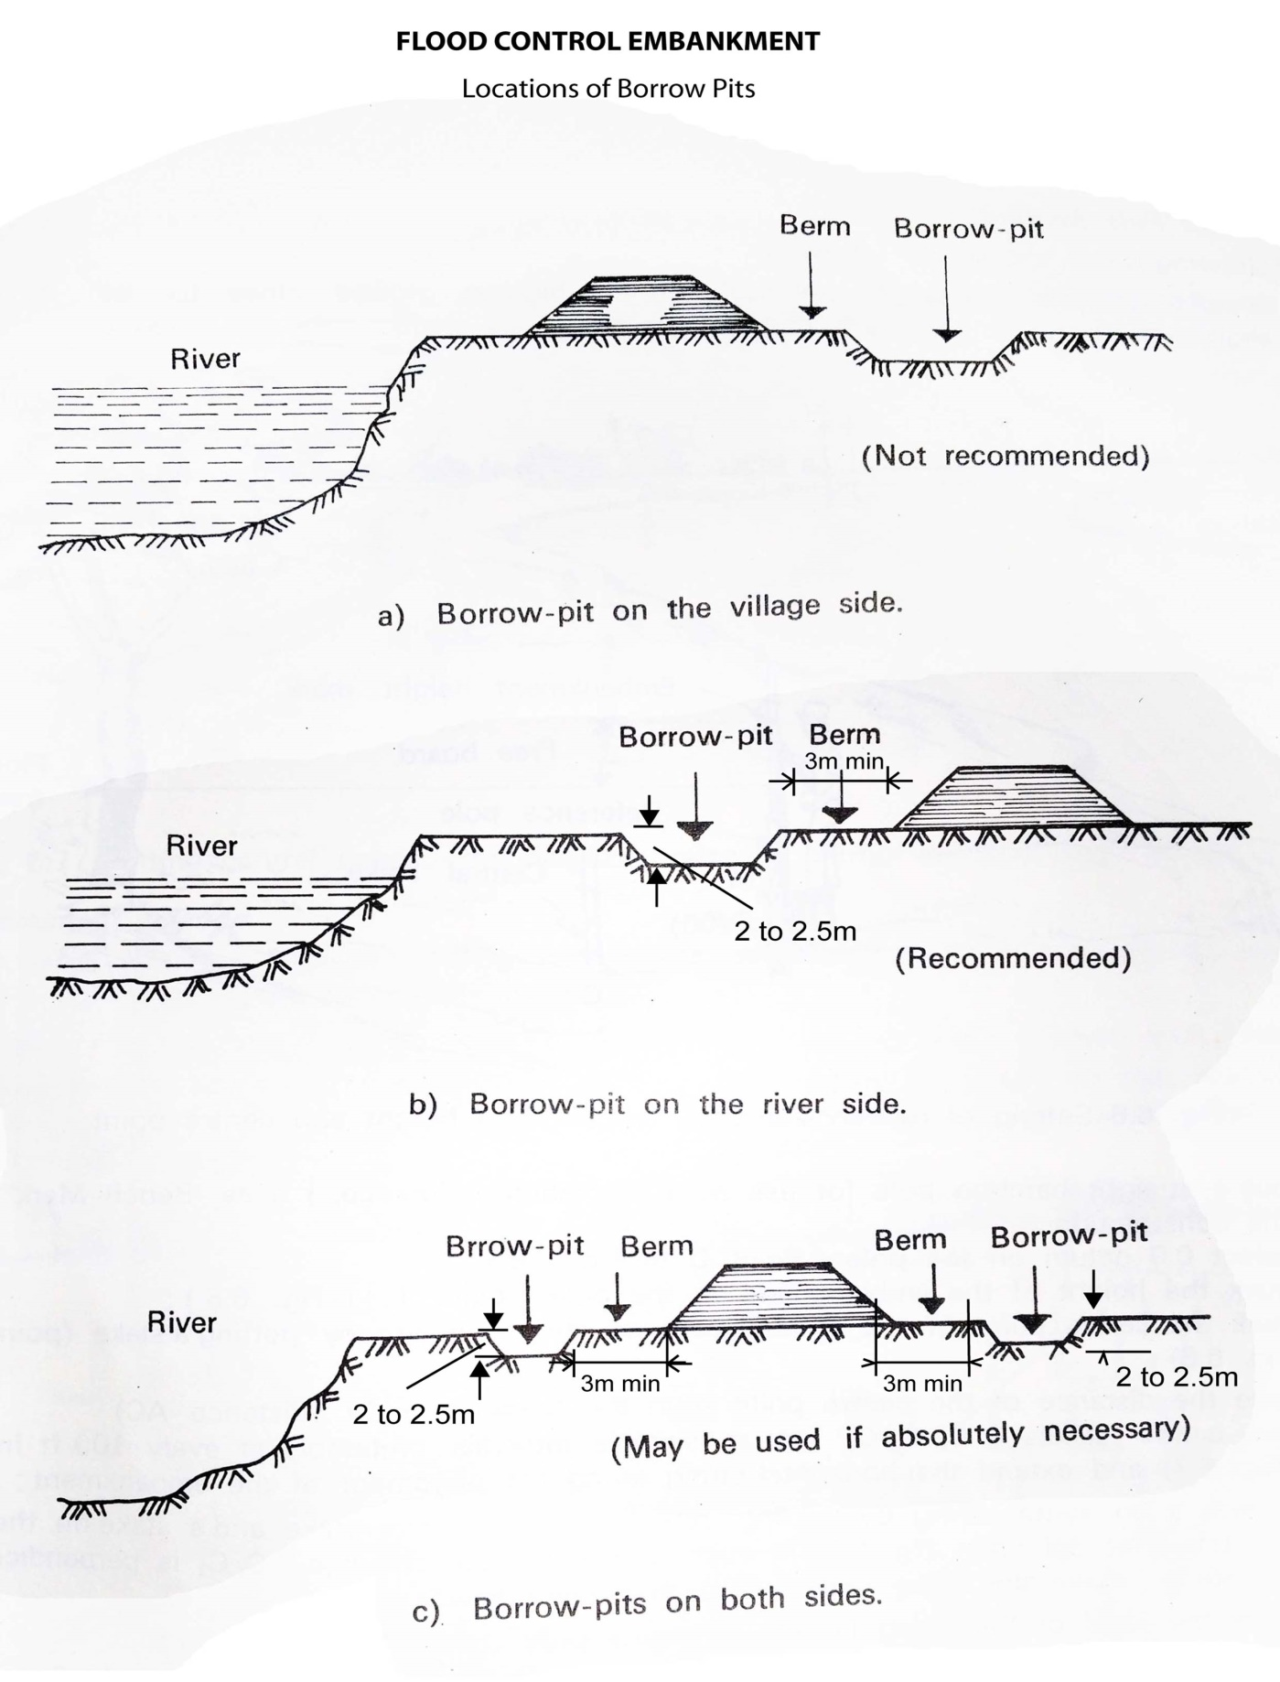
Location of Borrow Pits from The Toe of Embankment
(a) If Earth is Borrowed From The Country Side
20 m

Slide 50
Location of Borrow Pits from The Toe of Embankment
(b) If Earth is Borrowed From The River Side
20m

Slide 51
Location of Borrow Pits from The Toe of Embankment
(c) If Earth is Borrowed From Both Side
20m
20m

Slide 52
Thank you

